Slide 2
MACHINE LEARNING WITH GRAPH - FALL 2024

Slide 3

LightGCN for Movie Recommendation
Instructor: Dr, Nguyen Hong Thanh
Student: Le Hoang Long - 20232099M

Slide 4
Abstract
Movie recommendation is a fascinating field
A recommender system generates a tailored list of user suggestions based on two main factors:
Their inter actions with other users
Their preferences for specific items.
The technique of using user-user and user-item interactions to predict future recommendations is called Collaborative Filtering (CF).
We will examine a cutting-edge model based on Graph Neural Networks (GNN), specifically LightGCN as a movie recommender system using the MovieLens 1M dataset in the project

Slide 5
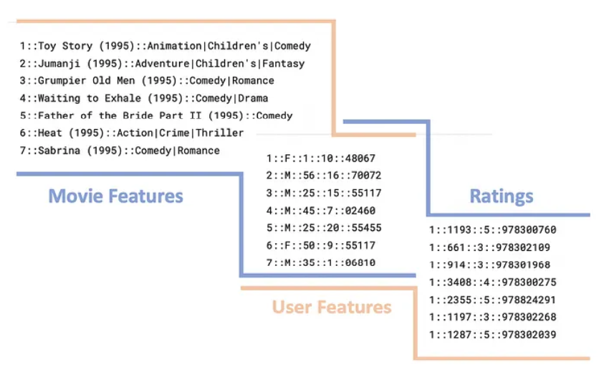
Dataset
MovieLens is an excellent dataset for training movie recommendation systems. The MovieLens 1M dataset is particularly well-suited for smaller projects, containing 1 million movie ratings, 4,000 movies, and 6,000 users.
The dataset is well-maintained and thoroughly validated, facilitating quick training. It has been referenced in numerous studies.
All features, including those related to users and movies, are easy to interpret. Movie features include titles and genres, while user features encompass gender, age, occupation, and zip code

Slide 6
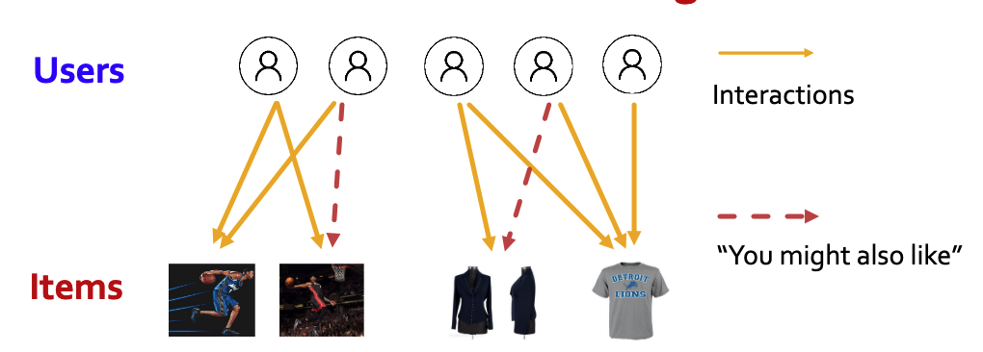
Graph Neural Network
The movie recommendation model is a sub-task of the linked-level prediction task, which involves predicting new, missing, or unknown connections based on existing ones. During testing, node pairs that lack established links are evaluated and ranked, with the top K pairs being predicted.

Slide 7
Graph Neural Network (cont)
In a Graph Neural Network (GNN), entities are represented as nodes, while relationships between them are depicted as edges. The graph can be enhanced by adding node and edge features for more information.
GNNs generate embeddings by considering the structure of the graph. Specifically, they use the embeddings of a central node’s neighbors—defined as nodes within a certain distance or "hop" from the central node—to update its own embedding.
This approach enables the GNN to produce similar embeddings for nodes that are closely related, both locally and from a broader perspective.

Slide 8
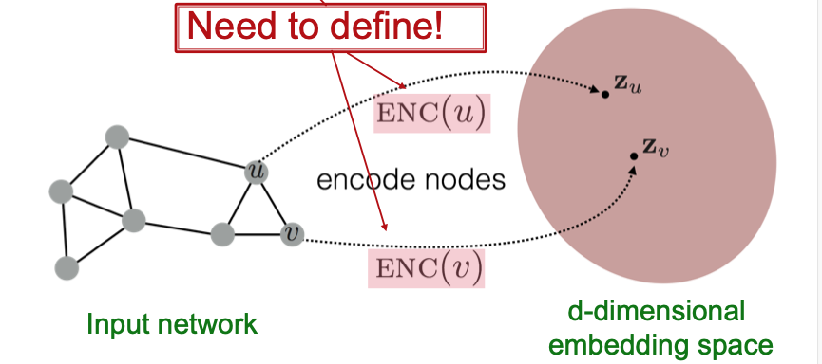
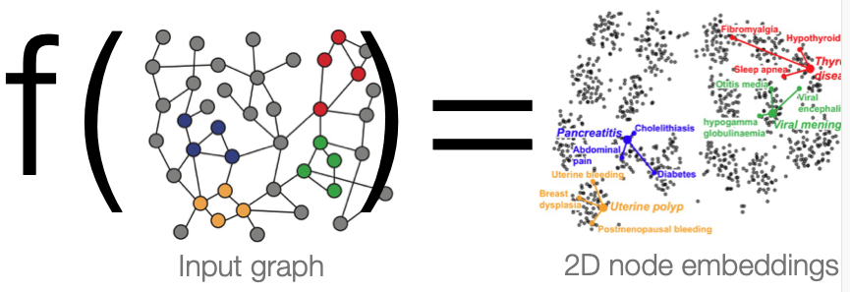
Graph Neural Network (cont)
It requires a mapping function f that maps nodes to d-dimensional embeddings such that similar nodes in the graph are embedded close together
Our objective is to establish the similarity between two nodes within the embedding space

Slide 9
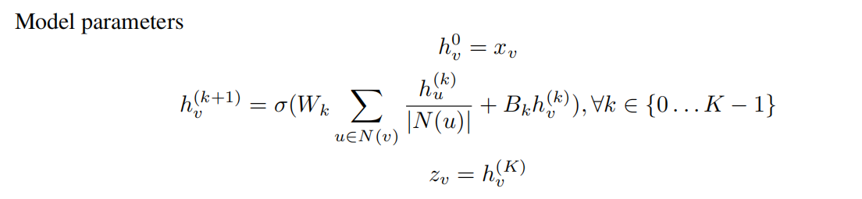
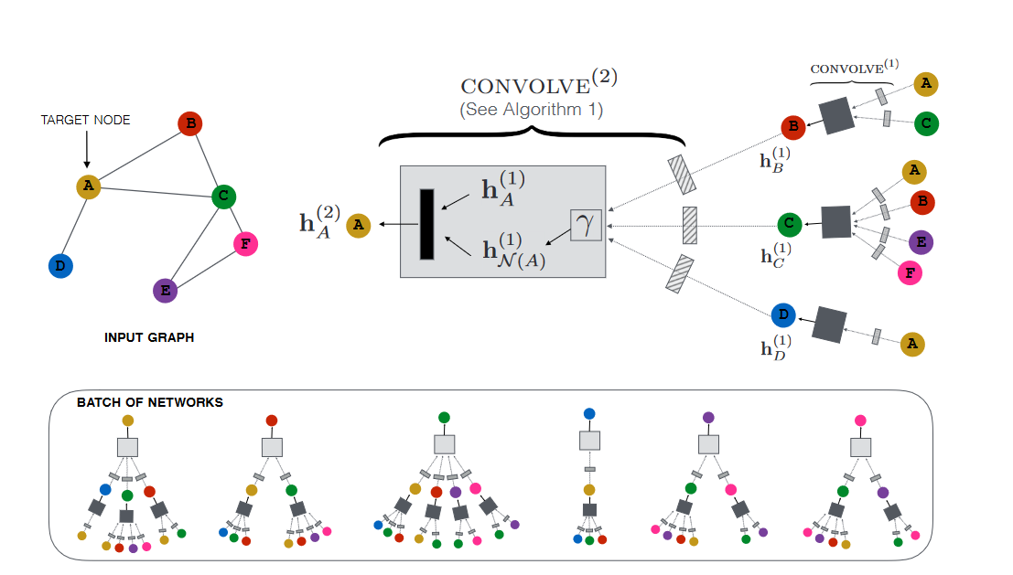

Graph Neural Network (cont)
The core concept of Graph Convolutional Networks (GCNs) is to learn node representations by smoothing features across the graph.
This is accomplished through iterative graph convolution, where the features of neighboring nodes are aggregated to create a new representation for a target node. Such aggregation can be abstracted as:

Slide 10
LightGCN
We observe that the two most prevalent features in GCNs—feature transformation and nonlinear activation—have minimal impact on collaborative filtering performance. Their inclusion complicates training and can hinder recommendation effectiveness.
LightGCN focuses solely on the essential aspect of GCNs: neighborhood aggregation. It learns user and item embeddings by linearly propagating them through the user-item interaction graph, ultimately using the weighted sum of embeddings from all layers as the final representation.

Slide 11
LightGCN (cont)
Like general GNNs, when applying LightGCN to the MovieLens dataset, we represent user-movie relationships as a bipartite graph. In this setup, users and movies are treated as two types of nodes on opposite sides, with edges between them signifying user-movie interactions.
Our goal is to predict whether a user likes a movie, so we define the edges in the bipartite graph as follows: an edge exists if a user rates a movie 3 or higher, while no edge is present if a user rates it below 3 or has not rated it at all.

Slide 12
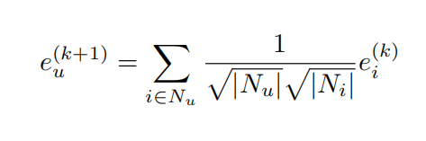
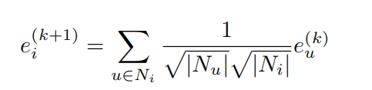
LightGCN (cont)
In LightGCN, we apply a simple weighted sum aggregator and abandon the use of feature transformation and nonlinear activation to compute updated embedding as the weighted sum of embeddings from all its neighboring items (movies) of each layer.

Slide 13
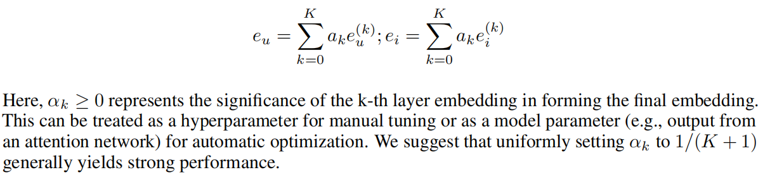

LightGCN (cont)
After K layers of LGC, we combine the embeddings from each layer to create the final representation for a user (or item)
The model prediction is defined as the inner product of user and item final representations:
which is used as the ranking score for recommendation generation. This inner product measures the similarity between the user and movie, therefore allowing us to understand how likely it is for the user to like the movie.

Slide 14
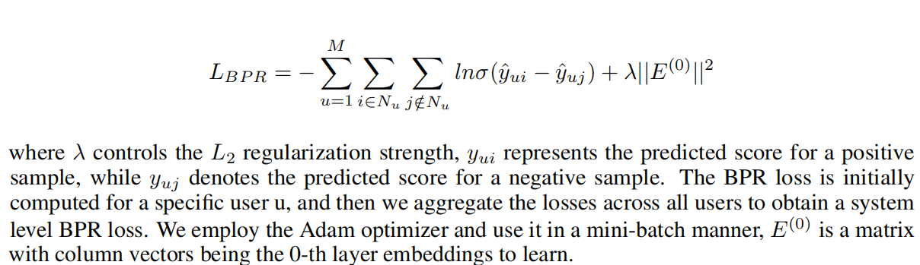
LightGCN (cont)
We employ the Bayesian Personalized Ranking (BPR) loss, which is a pairwise loss that encourages the prediction of an observed entry to be higher than its unobserved counterparts:

Slide 15
Implementation
The project is implemented with PyTorch-Geometric library and stored on Colab at https://colab.research.google.com/drive/196yJ019JSx49JlUIqHuriUsg8v9yNfZh?usp=sharing
For intralayer neighborhood aggregation, we implement a custom nn.MessagePassing layer (a generic GNN layer), LightGCNConv, takes the weighted sum of embedding embeddings.
For inter-layer combination, we implement a custom torch.nn.Module model, LightGCN, that stacks multiple LightGCN layers and computes the final user and item embeddings by taking a weighted sum of the embeddings at all layers.
For each user, we randomly sample n positive and negative movie examples to include in the training, validation, or test set. The value of n is a parameter that can be specified and tuned.
To assess training progress and model performance, we calculate the top K ground truth items that the user likes and dislikes.

Slide 16
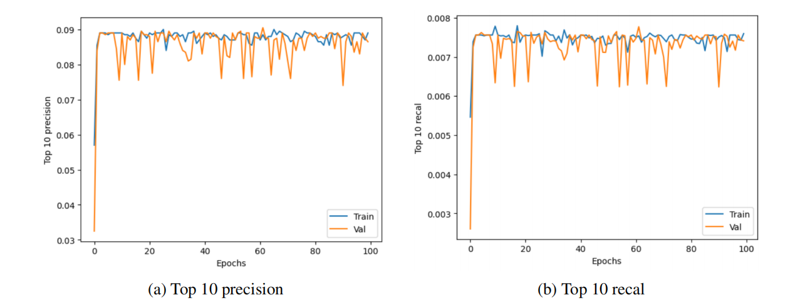
Insight & Result
We know that precision measures the accuracy of positive predictions, while recall measures the completeness of positive predictions.
In benchmarking recommendation systems, we typically avoid using overall accuracy because precision is more relevant when there are many relevant items but limited user attention.
For example, when presenting only the top 5 movie recommendations from a pool of thousands, Precision at K effectively measures the quality of that shortlist.

Slide 17
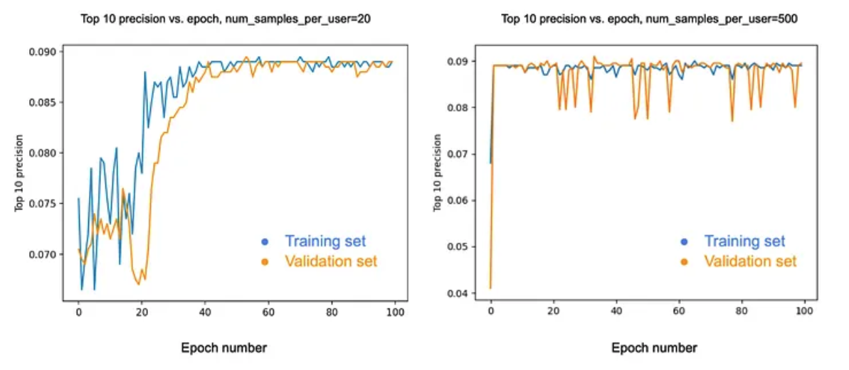
Insight & Result
We achieved a top 10 test precision of 0.0890 with 20 and 500 samples per user. However, plotting the training curves for both models, it becomes clear that training converges much faster with a larger number of samples per user.
This is due to the random sampling process; we use only a small portion of over six thousand movies for training. A smaller sample size can lead to significant variance based on the selected subset, as some subsets may be more informative than others.

Slide 18
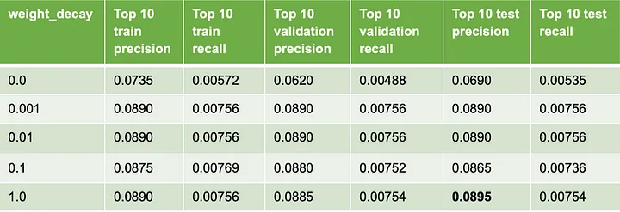
Insight & Result
We found that weight decay, which regulates the level of regularization, and the number of samples per user significantly impact our top-k recommendation precision. To further investigate, we performed ablation studies on each of these parameters individually.

Slide 19
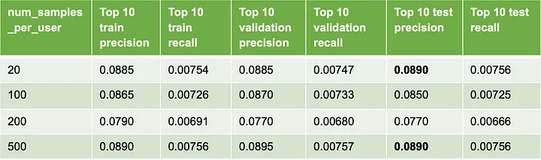
Insight & Result
The trend in top-10 test precision with increasing num_samples_per_user is not very clear. We obtained a top-10 test precision of 0.0890 with both 20 samples per user and 500 samples per user.

Slide 20
References
Gianluca Malato. (2021) Precision, recall, accuracy. How to choose?.
EvidentlyAI. (2021) Precision and recall at K in ranking and recommendations.
Jure Leskovec. (2024) CS224W: Machine Learning with Graphs..
He, X., Deng, K., Wang, X., Li, Y., Zhang, Y., & Wang, M. (2020). LightGCN: Simplifying and Powering Graph Convolution Network for Recommendation.
PyTorch Geometric (PyG): https://pytorch-geometric.readthedocs.io/en/latest/
F. Maxwell Harper and Joseph A. Konstan. The movielens datasets: History and context. ACM Trans. Interact. Intell. Syst., 5(4), December 2015.
Stanford CS224W GraphML Tutorials: https://medium.com/stanford-cs224w/lightgcn-for-movie-recommendation-eb6d112f1e8

Slide 21
THANK YOU !

